Slide 1
EDS CSV Extraction Guide
Joseph Kern
January 8th, 2020
Email: jkern34@gatech.edu

Slide 2
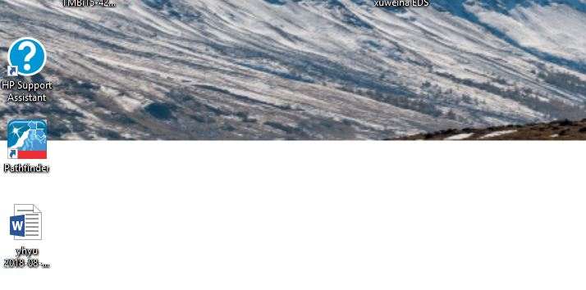
1. Open Pathfinder

Slide 3
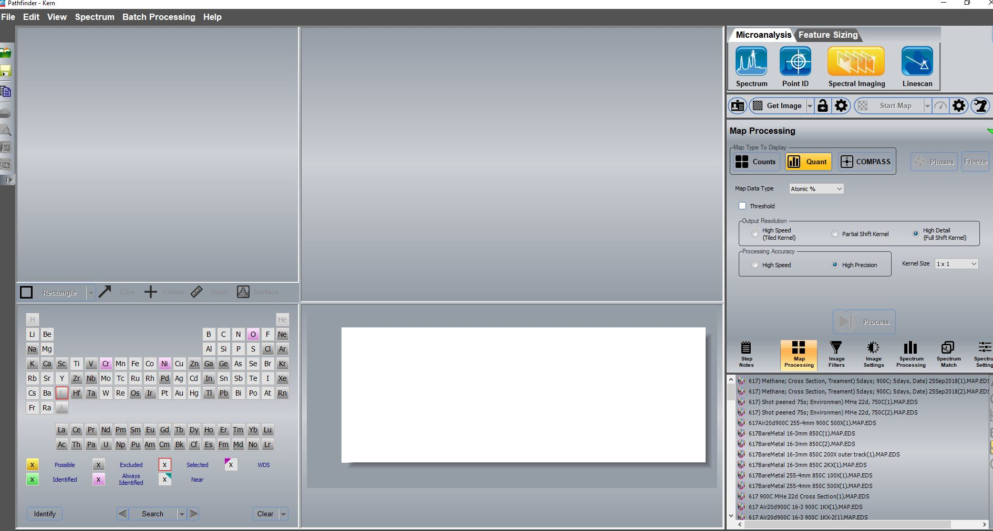
2. Choose your folder

Slide 4
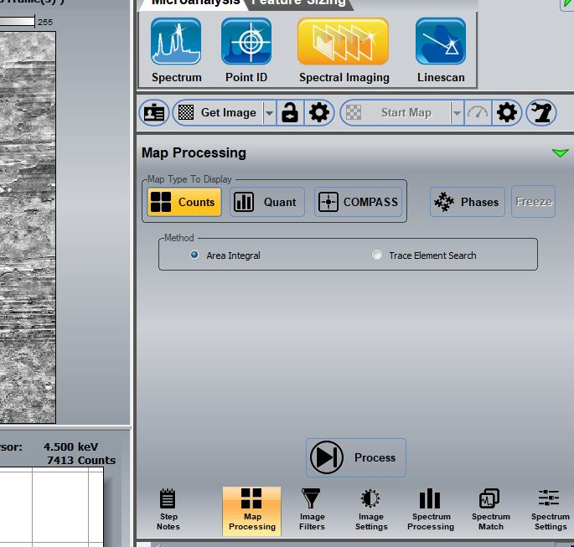
3. Choose Spectral Imaging. If you haven’t taken the EDS Scan yet do so as normal. Otherwise choose the old EDS reading you want.

Slide 5
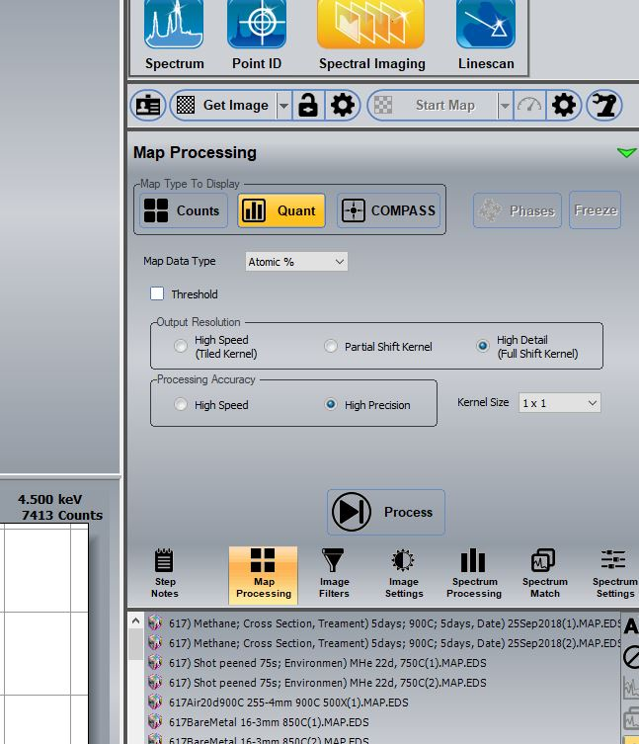
4. Once you have your reading (new or old), choose map processing, and change to Quant. Change “Map Data Type” to “Atomic %”, “output resolution” to “high detail”, “processing accuracy” to “high precision”, and “kernel size” to “1x1”. Process. For Weight % the procedure is the same, just switch “Map Data Type” to Weight %.

Slide 6
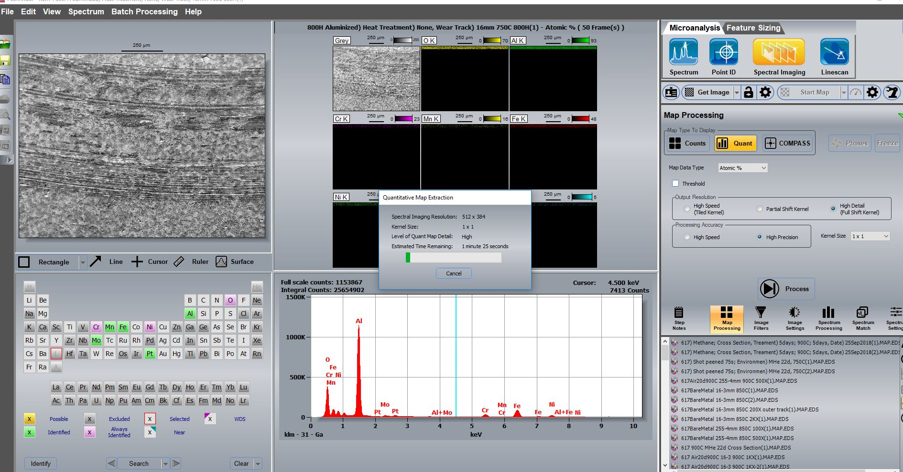
5. Process your scan from counts to Atomic%

Slide 7
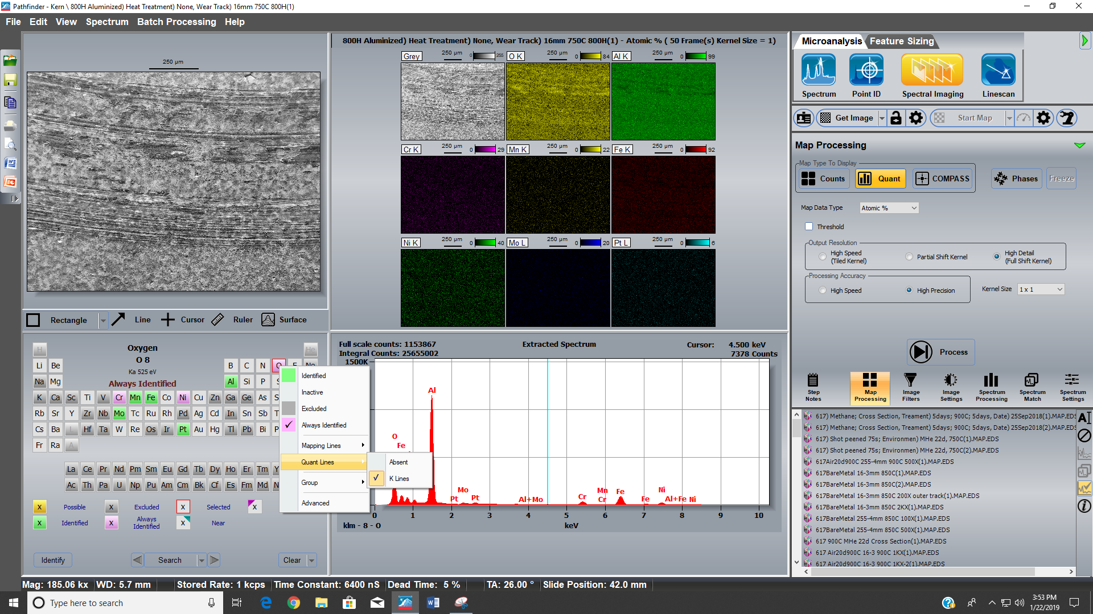
6. Make sure you have all the element readings you need. You can left click an element and hover over “quant lines” to ensure the K or L lines are checked

Slide 8
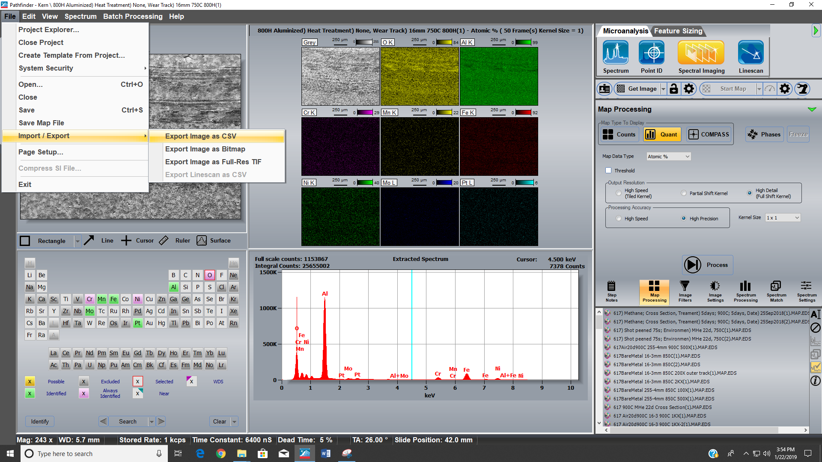
7. Export the image to CSV: Go to “file”, “import/export” and choose “export image as CSV”

Slide 9
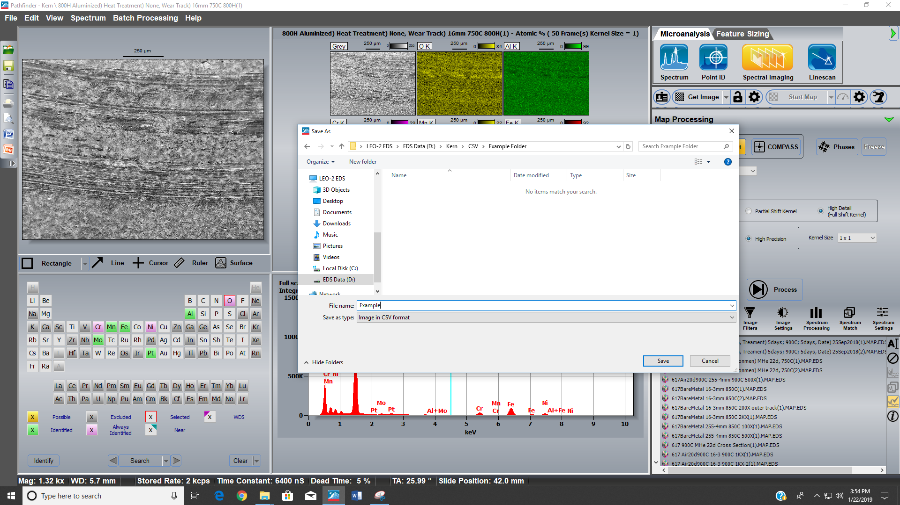
8. Choose your CSV save folder. The file name you choose will have the format: filename_element K/L

Slide 10
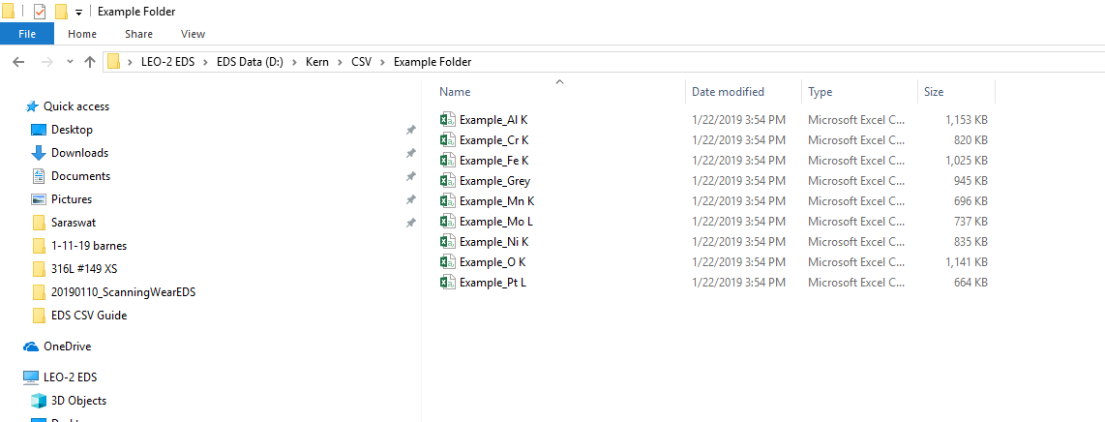
9. Ensure the grey image is saved in CSV format as well. This will be entitled filename_Grey. If it is there skip to step 13

Slide 11
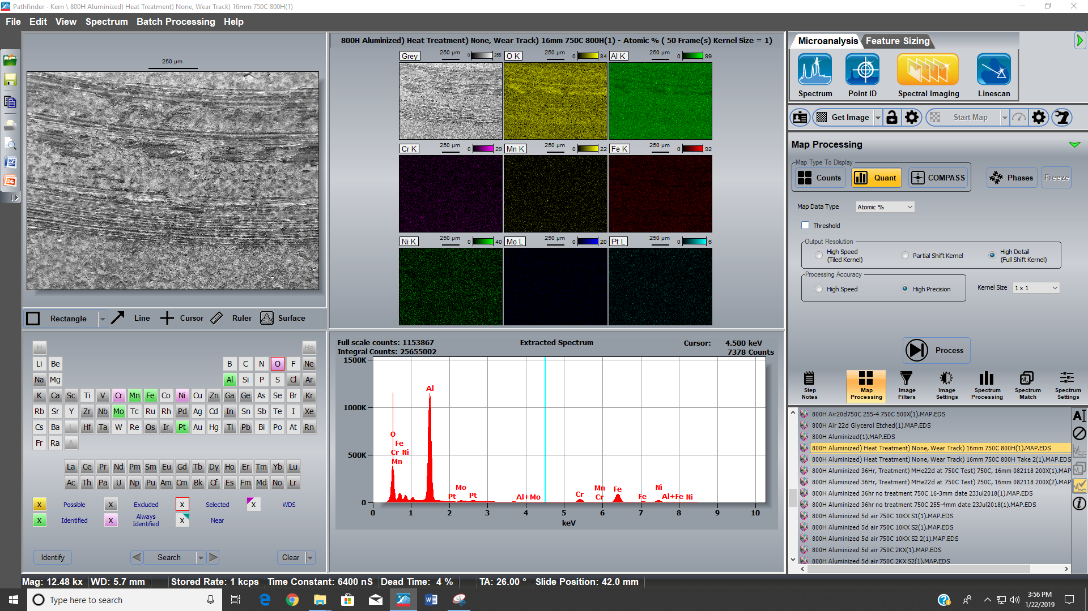
10. If the Grey image CSV is not saved, then click a random old file and then reload the EDS mapping you care about (see step 11)

Slide 12
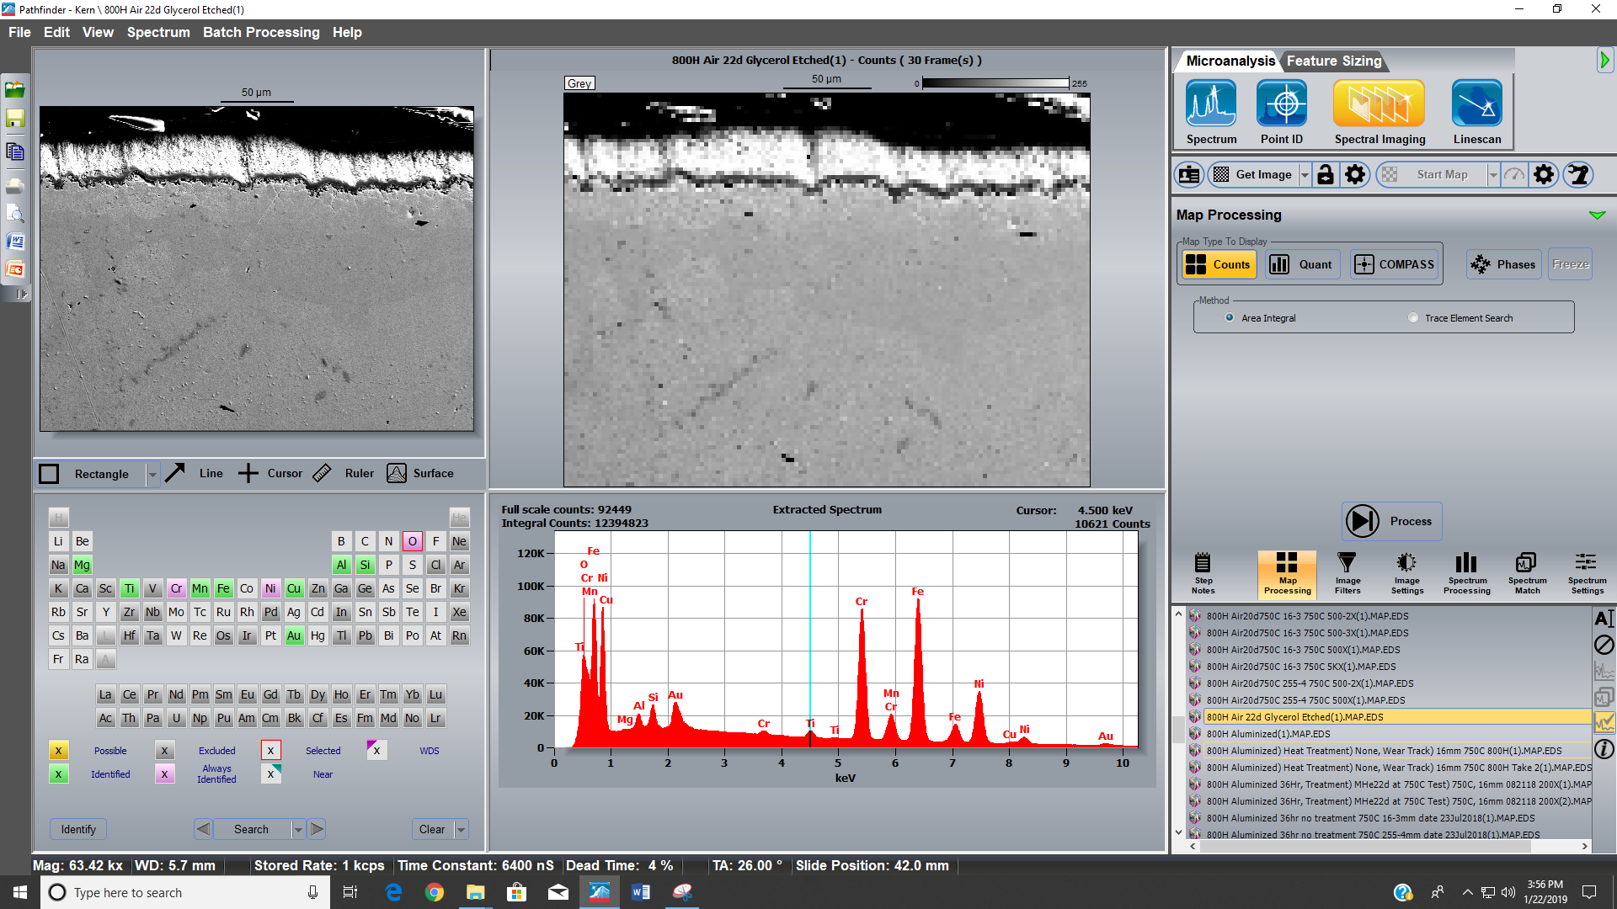
11. Random file

Slide 13
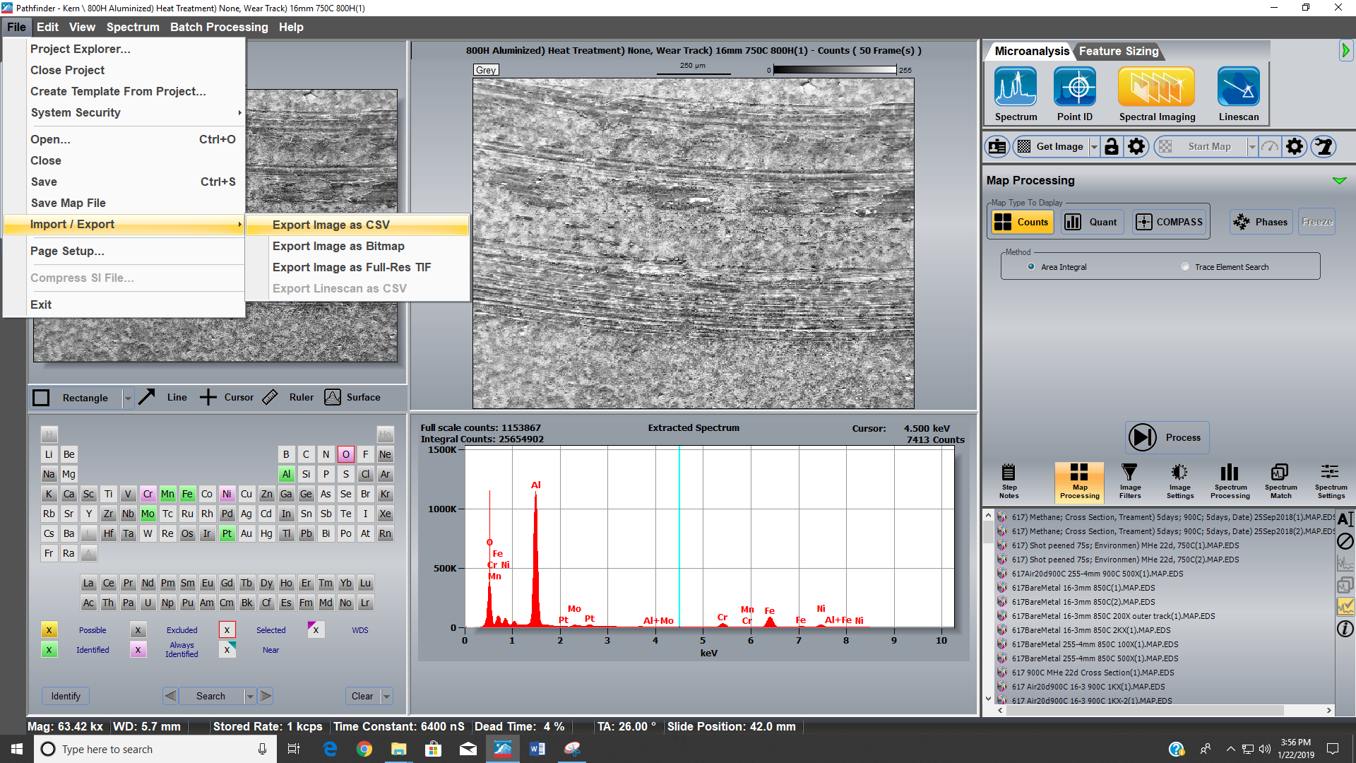
12. File you care about. With just the image open (do not click process) go to “export image as CSV” again and save it as your filename (not filename_Grey)

Slide 14
Contacts for questions
Joseph Kern
email: jkern34@wisc.edu

